Slide 1
Sur5val
NSO procedures
Note: for 15 teams, at 2 ½ minutes a bout, that’s 105 Jams over 4 1/2hours!!!
Notes:
To make this a round robin tournament or Sur5val bout, where each team plays each other, then for this example, there would be n/2(n-1) jams where n=6, so we would have 6/2(6-1) jams which is 15 jams, if each jam runs for 2 ½ minutes then you have the bout taking 37 ½ minutes.
For 15 teams, it works out at 15/2(15-1) times 2 ½ minutes and that is 105 jams over 4hrs 22 mins!!! ⬅
Lastly, this process requires
a) a clear, closely located area where the teams can sit - Benches
b) a NSO to ensure the correct teams are notified to move from the Benches to the Trackside seats – they have 2 minutes to do this.
This presentation is based on what Windsor Roller Derby (UK) did for their Sur5val

Slide 2
Contents
Overview of the schedule
NSO roles
Paperwork and examples
Penalty system to be used
Scoring

Slide 3
Heats and Jams
We will have 3 rounds of 5 heats, each heat has 7 Jams
Each heat runs for 20 mins
Between each heat, there will be a 2 min break
Between each round there will be a 10 min break

Slide 4
NSO’s
We have 1 team with lots of NSO’s. The team will have :
2x for scorekeeping(SK)
2x scoreboard operators(SKO) – 1 for the jam and 1 for the other displays(optional)
2x jammer takeouts operators(JTO) – they record the jammer take out and penalties
1x JT – jam timer(JT)
2 or 3 penalty trackers(PT)
2x line up managers(LUM) - will be appointed to make sure the right teams are track side and on track at the right times
HNSO – they the ones on beta blockers!
Notes:
NSO’s
We have 1 team
We have:
2x scorekeepers - 2x for scorekeeping
2x scoreboard operators – 1 for the jam and 1 for the other displays,(nice to have)
1x JT
3x penalty trackers – on track one for each team and one for the white board
2x LUM – line up manager
HNSO
The extra penalty trackers – can resolve issues outside of the current jam, or swap with other people

Slide 5
The paperwork
At the start of the heat:
NSO’s each get a team roster for that heat – and it will be displayed on the wall
The Jammer Take Out Trackers(2x) gets 7 lots of ‘Jammer Take out’ forms – 1 per team
The Penalty Trackers(3x) gets 7 lots of ‘penalty’ forms – 1 per team and 1 pen for the whiteboard
The ScoreKeepers (2x) get 7 lots of ‘Score’ forms – 1 per team
The LUMs gets the LUM sheet (a bigger team roster form) & all the team forms ‘IBRF’ forms – 1 per team
Notes:
Each heat will require 7 teams on the benches, which means the NSO roles with stat sheets (Penalty Trackers, Score Trackers, Jammer Take Out Trackers) will have 7 sheets each plus a team roster . There will only be the standard 30 second breaks between each jam in a heat, so it is vital that we are on the ball and can change the stat sheets over quickly without losing any of the data. There are instances where 1 tracker will end up with both sheets for a jam on their clipboard, so some quick paper swapping will be required
The stats sheets are colour coded to match the team colours, and have the jam numbers they are playing in on the sheets.
roles:
The jam ref signals to their scoreboard operator points awarded; lead and passes. This is standard WFTDA practise.
The jammer take out trackers (JTO) records which blocker took out the jammer, by either blocking off the track or taking the jammer down
Penalty Trackers fill out the penalty forms – like WFTDA practise
Scorekeepers operate as per standard wftda – filling out the standard scorekeeping form
Similarly with the SBO and HNSO
The additional SBO fills out the scoresheet for the jam so we have a paper record of the results and operates the other scoreboard
IWB – tracks all teams on the white boards
Jam refs will be assigned a penalty tracker, score tracker and JTO tracker for the day.
The HNSO oversees…
The trackers will be assigned as either ‘Black’ team or ‘White’ team. This will correspond to their paperwork so each tracker knows which team they are tracking for each jam. It will be the penalty trackers responsibility to tell their jam ref which team they are refereeing for each jam.
What occurs at the start of each heat, is that each JTO, SK, PT will have a copy of the team roster for that heat and up to 7 sheets to manage, 1 for each team, however as one team can play more than once per heat, there may only be 6 or 5 or 4 sheets for each person. They respective JTO’s, SK’s and PT’s may have to swap team sheets between each other, for example in Jam #1, team A I splaying team B, in Jam #2 team C plays team A. Therefor the JTO’s, SK’s and PT’s must pass team A sheet to the other JTO, SK or PT.

Slide 6
Prior to the Heat
Jam refs will be assigned a score keeper, penalty tracker and JTO tracker for the heat.
It is HNSO responsibility to ensure that the JTO’s and penalty trackers have the correct paperwork
During the jam
It is the JT’s responsibility to ensure that the JTO’s and penalty trackers have the correct paperwork. They have two minutes to sort out the paperwork during the jam. Remember that the jammers cannot call off the jam

Slide 7
Paperwork
Team Details
Penalties
Scorekeeping
Jammer Takeout
4) Score tracker
5) Team rosters for the rounds, heats and jams
5) Penalty white board – ‘ The board of Shame’ see further on for an example
Examples follow

Slide 8
TEAM
TEAM | Examplehers |  | Score | 100
# of players | Skater # | Skater Name |  |  | Penalties Jammer Take Outs
1 | 101 | Numchucks |  |  | 2
2 | 20 | Faulty Wheels
3 | 30 | Massive Hits |  |  |  |  |  |  | 3
4 | 51Q | Kleenherup |  |  | 1
5 | 666 | Spredsheets
Team sheet – fill in first
Notes:
Fill in this sheet first!
It populates the rest!
Then print it off and attach the sheets to coloured paper
Or
Change the colours to suit

Slide 9
TEAM: | Examplehers |  |  |  |  |  |  |  |  | PENALTIES
# | PENALTY MINUTES |  |  |  |  |  |  | FO/EXP | TOTAL | Codes
101 | B | N |  |  |  |  |  |  | 2 | B | H | X | A | S
 | 1 | 7 |  |  |  |  |  |  |  | Back Block | Blk w/ Head | Cut Track | High Block | Skate OOB
20
 |  |  |  |  |  |  |  |  |  | E | F | M | L | N
30 |  |  |  |  |  |  |  |  |  | Elbows | Forearms | Multi-Player | Low Block | Insubord'n
51Q | I |  |  |  |  |  |  |  | 1 | C | G | I | P | O
 | 15 |  |  |  |  |  |  |  |  | Dir of Play / Clockwise / Stopped | (Gross) Misconduct | Illegal Proc / False Start / Violation | Out of Play / Destroying / Failure | OOB Block / OOB Assist
666
 |  |  |  |  |  |  |  |  |  | Z
 |  |  |  |  |  |  |  |  |  | Delay of Game
PENALTY / Jam #: Enter codes for penalties in the upper row and jam # in the lower row for each skater.
FO/EXP: Foul Outs (FO) for penalty minutes should be marked as PM. Expulsions (EXP) should be listed by the appropriate penalty code.
TOTAL: At the end of the tournament, add the number of penalties for each skater for that period and put it in the "TOTAL" column.
Penalties – a sample form
Notes:
This lists all the penalties that a player accumulates. The major penalty codes are listed.
This form is colour coded and is meant to match the team colours. The columns are:
# - the skaters number
Penalty minutes – enter in the top box the penalty code and in the box below the jam number. The jam number is got from the team roster listing all the jam numbers
FO/EXP – foulout expulsion codes
Total – the total number of penalties for each player
The cells listed ‘Jams 1-h 4-h 7A…etc ‘ these are automatically populated by the spreadsheet when the penalty data is entered upon the computer.

Slide 10
 | TEAM: | Examplehers |  |  |  |  |  |  |  |  |  |  | SCORE
Game | JAM | Jammer's Number | LEAD | INJ. | NP | Pass 2 | Pass 3 | Pass 4 | Pass 5 | Pass 6 | Pass 7 | Pass 8 | Pass 9 | Pass 10 | Jam Total | Game Total
1 | 1 | 101 | x |  |  | 4 | 4 |  |  |  |  |  |  |  | 8 | 8
2 | 1 | 101 |  |  |  | 4 |  |  |  |  |  |  |  |  | 4 | 12
3 | 7 | 101 | x |  |  | 4 | 4 |  |  |  |  |  |  |  | 8 | 20
4
5
6
7
8
9
10
11
12
13
14
15
16
 | 3 | PERIOD TOTALS | 2 |  |  | 12 | 8 |  |  |  |  |  |  |  | 20 | 20
 | JAM: Write in jam number starting from 1. If there is a star pass move to the next line and indicate with SP in the Jam # column.
 | Lead = Lead Jammer. Call = Called Jam, when the listed jammer successfully calls off the jam before jam time runs out. This is checked whether or not the jam was called legally.
 | INJ = Called For Injury before the natural end of the jam. NP = First pass is not completed by the end of the jam (No Pass). ALL of the Lead and Call categories should be marked with an X.
THIS IS VERY SIMILAR TO THE WFTDA STANDARD FORM
Notes:
The difference is: there is no ‘CALL’ column as the Jammer cannot call off a jam. It runs for 2 minutes.
There is no ‘LOST’ column, the jammer cannot loose lead, they cannot call it off!

Slide 11
TEAM: | Examplehers |  |  |  |  |  |  |  |  |  |  |  |  |  |  |  |  |  |  |  |  |  |  |  |  |  |  |  | JAMMER TAKE OUTS
# |  |  |  |  |  |  |  |  |  |  |  |  |  |  |  |  |  |  |  |  |  |  |  |  |  |  |  |  |  |  |  |  |  |  |  |  | TOT | Jammer
101 |  |  |  |  |  |  |  |  |  |  |  |  |  |  |  |  |  |  |  |  |  |  |  |  |  |  |  |  |  |  |  |  |  |  |  |  |  | Take Outs
 |  |  |  |  |  |  |  |  |  |  |  |  |  |  |  |  |  |  |  |  |  |  |  |  |  |  |  |  |  |  |  |  |  |  |  |  |  | T
20 |  |  |  |  |  |  |  |  |  |  |  |  |  |  |  |  |  |  |  |  |  |  |  |  |  |  |  |  |  |  |  |  |  |  |  |  |  | Jammer Down
30 | T | O | T |  |  |  |  |  |  |  |  |  |  |  |  |  |  |  |  |  |  |  |  |  |  |  |  |  |  |  |  |  |  |  |  |  | 3 | O
 | 1 | 1 | 4 |  |  |  |  |  |  |  |  |  |  |  |  |  |  |  |  |  |  |  |  |  |  |  |  |  |  |  |  |  |  |  |  |  |  | Out / Off Track
51Q
666 | O | O |  |  |  |  |  |  |  |  |  |  |  |  |  |  |  |  |  |  |  |  |  |  |  |  |  |  |  |  |  |  |  |  |  |  | 2
 | 12 | 12
TAKEOUT CODE/JAM # Enter take out code in the upper row and jam # in the lower row for each skater. No heat number is entered, that can be inferred from the team roster
Jammer take out form – T = Takedown, O = Out of track
Notes:
The Jammer take outs. The player who takes out the jammer, alongside the skater number, enter the takedown code. At the end of the bout, the number of takeouts is manually totalled in the ‘TOT’ box

Slide 12
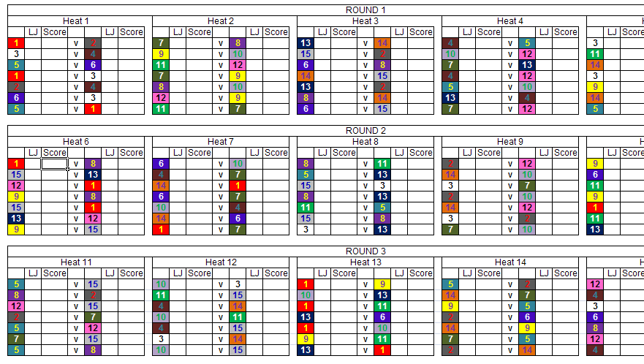
Score Tracker
Notes:
Score Tracker – and doubles up as a the bout schedule and team rosters too

Slide 13
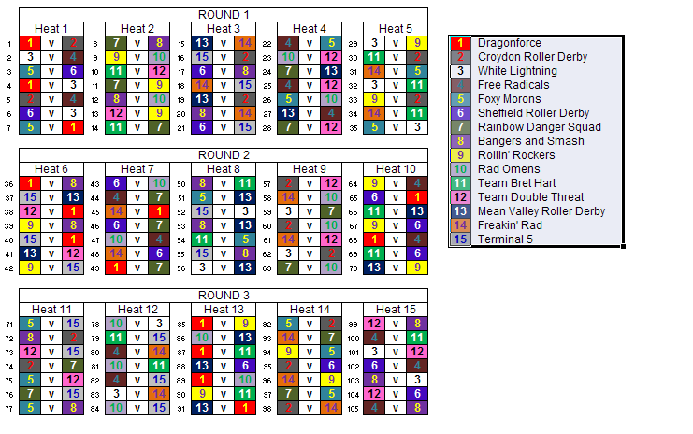
Team roster
Notes:
The team schedule – the bout revolves around the jam number.
Using a jam number, the NSO can determine what bout was played, with what teams, the scores, penalties, JTO’s

Slide 14
During the jam
An example: Team Tortise vs Rabbit. Team Tortise has members i,j,k,l with jammer m, team Rabbit has members a,b,c,d with jammer e
Jam start
Blocker ‘i’ blocks jammer ‘e’ off the track
The JTO for team Tortise records blocker ‘i’ blocked out - ‘O’ on jam number 1
i) Blocker ‘a’ downs jammer ‘m’
ii) The JTO for team Rabbit records Blocker ‘a’ Take downs - ‘T’ on jam number 1
Jammer ‘e’ takes lead
For Team Tortise, the JR signals to the SK – lead jammer – SK updates the scoresheet
SK informs the SBO who updates the scoreboard with the +1 and lead jammer status
i) Jammer ‘e’ achieves a second pass – including the other jammer
ii) For Team Tortise JR signals to the SK – lead jammer – SK updates the scoresheet
iii) SK informs the SBO who updates the scoreboard with +5
Jammer ‘m’ commits a major – say ‘cutting’
A referee calls it, the JTO for team Tortise updates their penalty sheet with ‘X’ and the jam number 1
At the end of the jam, The PT updates the penalty white board if required

Slide 15
Communication NSO’s/ref’s before the jam
The LUM will ensure the team on the bench are wearing the correct colour and announce the teams playing.
The JT will ensure that the penalty trackers, scorekeepers and JTO’s have the correct team sheets
Once the JT is satisfied, they will notify the Head Ref who will notify the JT to start the game
This will be done as below:
The Jam Timer will verbally check with the SK’s, PT’s and JTO’s by announcing
The next bout is between team ‘A’ and ‘B’
JTO’s are you ready?
PT’s are you ready
SK’s are you ready?
Upon a verbal ‘yes’ or thumbs up, the JT will pass control to the Head Ref
Notes:
Jam refs will be assigned a penalty tracker, score tracker and JTO tracker for the day.
It will be the penalty trackers responsibility to tell their jam ref which team they are reffing for each jam.

Slide 16
After the Jam
The teams rotate as per the roster
Referees check their status
The NSO’s setup for the next Jam by:
LUM’s ensure the teams are benched and announce the next teams
Jam refs, JT’s, PT, JTO, IWB and scorekeepers - identify the teams coming on
- select the correct team forms to be used. It may be necessary to swap forms between the SK’s, or the JTO’s, or the PT’s
- the SBO #1 checks that the SBO #2 has the scores for that jam entered into the Score Tracker, saves the current score board details and then selects the next jam
the SBO #2 updates the score tracker and updates their score board display
- It will be the Jam timers responsibility to ensure the correct teams paperwork is being used during the jam. See the previous slide.
Notes:
Jam refs will be assigned a penalty tracker, score tracker and JTO tracker for the heat
This will correspond to their paperwork so each tracker knows which team they are tracking for each jam. It will be the penalty trackers responsibility to tell their jam ref which team they are refferring for each jam.

Slide 17
After the Heat
The teams rotate as per the roster
Referees check their status
The NSO’s setup for the next jam by:
LUM(HNSO) ensure the teams are retired to the skater rest area and/or are benched and wearing the correct panties, the correct paperwork is distributed:
The scoreboard – paper version is updated
The team forms, scorekeeping, Jammer take out and penalty forms are distributed to the JTO, PTs, IWB and scorekeepers by the HNSO
Be in position for the first jam of the new heat
Notes:
Jam refs will be assigned a penalty tracker, score tracker and JTO tracker for the day.
It will be the jam ref’s responsibility to check with the JTO which team they are reffing for each jam.

Slide 18
List of programs and paperwork used to run the Sur5Val
Scorekeeping program
Sur5Val(from Windsor)**
Paperwork
Sur5al_Remix_programme & LUM Schedule(spreadsheet)
round and heat Schedule **
LUM schedule
scorekeeping grand totals ##
Team Sheets – 1 per team, colour coded
Penalties
ScoreKeeping ##
Jammer Takeout
** the schedule can be displayed from the Sur5val program and will be printed
## the score for the Jam, heats and rounds can be displayed from the Sur5val program
Notes:
Total paperwork required in pages:
Each team requires 1x penalty, scorekeeping & jammer takeout, for 15 teams that is 15 X 3 = 45 pages
Each NSO requires the Heat roster. We have around 20 of them! Lets add in extras (20) and make it 40 pages
LUM sheet – easier to read – 4 pages
Scorekeeping grand total – 1 page
Around 100 pages of printing

Slide 19
The penalty system for sur5al
penalties last 30 seconds and are not carried over to the next jam 1) When a player reaches 5 majors their name will be written on the board by a penalty tracker
2) when a player reaches 6 majors their name is circled warning them
and refs they have 6 majors
3) when a player reaches 7 majors their name receives a line thought it. See photo attached for demonstration. Note that their names will not be written three times on board, only once, this is just a demonstration. There can be multiple names on the board, one for every player with 5 or more penalties.
Notes:
This board will be updated at the end of the jam, HOWEVER it can be left to the end of the heat if timing becomes an issue.

Slide 20
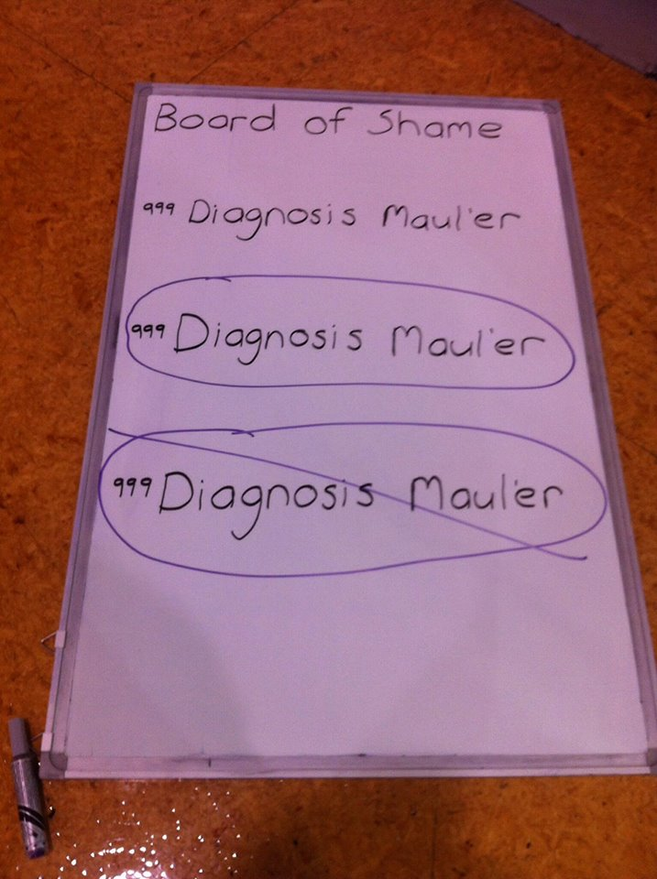
Notes:
Yes – we are bored in seeing anyone on this board!

Slide 21
Sur5val team Scoring
During the jam, points are award as per a standard game – ‘Each jammer must first complete a non-scoring pass through the pack, which determines which jammer (if any) is the lead jammer. After this, the jammer scores a point the first time each lap that she passes each opposition team member, including the other team's jammer’ in addition, 1 point is awarded to the lead jammer.
At the end of the jam, the points are totalled for each team and assigned as
jam won – 5 points
jam draw – 2 points to each team
Jam lost – 0 points
Notes:
There are separate scoring (and reward categories ☺) for the best jammer take out and best lead jammer

Slide 22
Displaying the score
The jam scoreboard displays the points scored by the jammer in that jam
The team scoreboard displays the points scored by the team winning, drawing or loosing that jam
An example. Team white versus team black. Team white jammer scores 11 points and is lead jammer. Team black jammer scores 4 points
Jam display is White 11 and lead, Black 4
Team display is White 6 points, Black 0

